Slide 1


MEDSHARE
A Medicine Sharing App inside campus/hostel buildings.
AMBARISH MANNA
RISHIKA PAUL
SANDIP PAN
RUCHI SHARMA
(23BCS11948)
(23BCS10869)
(23BCS13539)
(23BCS10713)

Slide 2
Problem Statement
Ensuring timely access to essential medicines in campus and residential communities through peer-to-peer sharing solutions.
According to the World Health Organization (WHO), approximately 50% of the global population lacks timely access to essential medications, such as analgesics, antipyretics, and first-aid supplies.
A recent survey of university students revealed that 72% faced difficulties obtaining basic medications (e.g., paracetamol, antacids, or cough syrups) during late-night hours or weekends.
Studies from health organizations show that this problem isn't just found in rural or isolated areas; it also exists in cities where people often assume that medical stores are easily accessible.

Slide 3
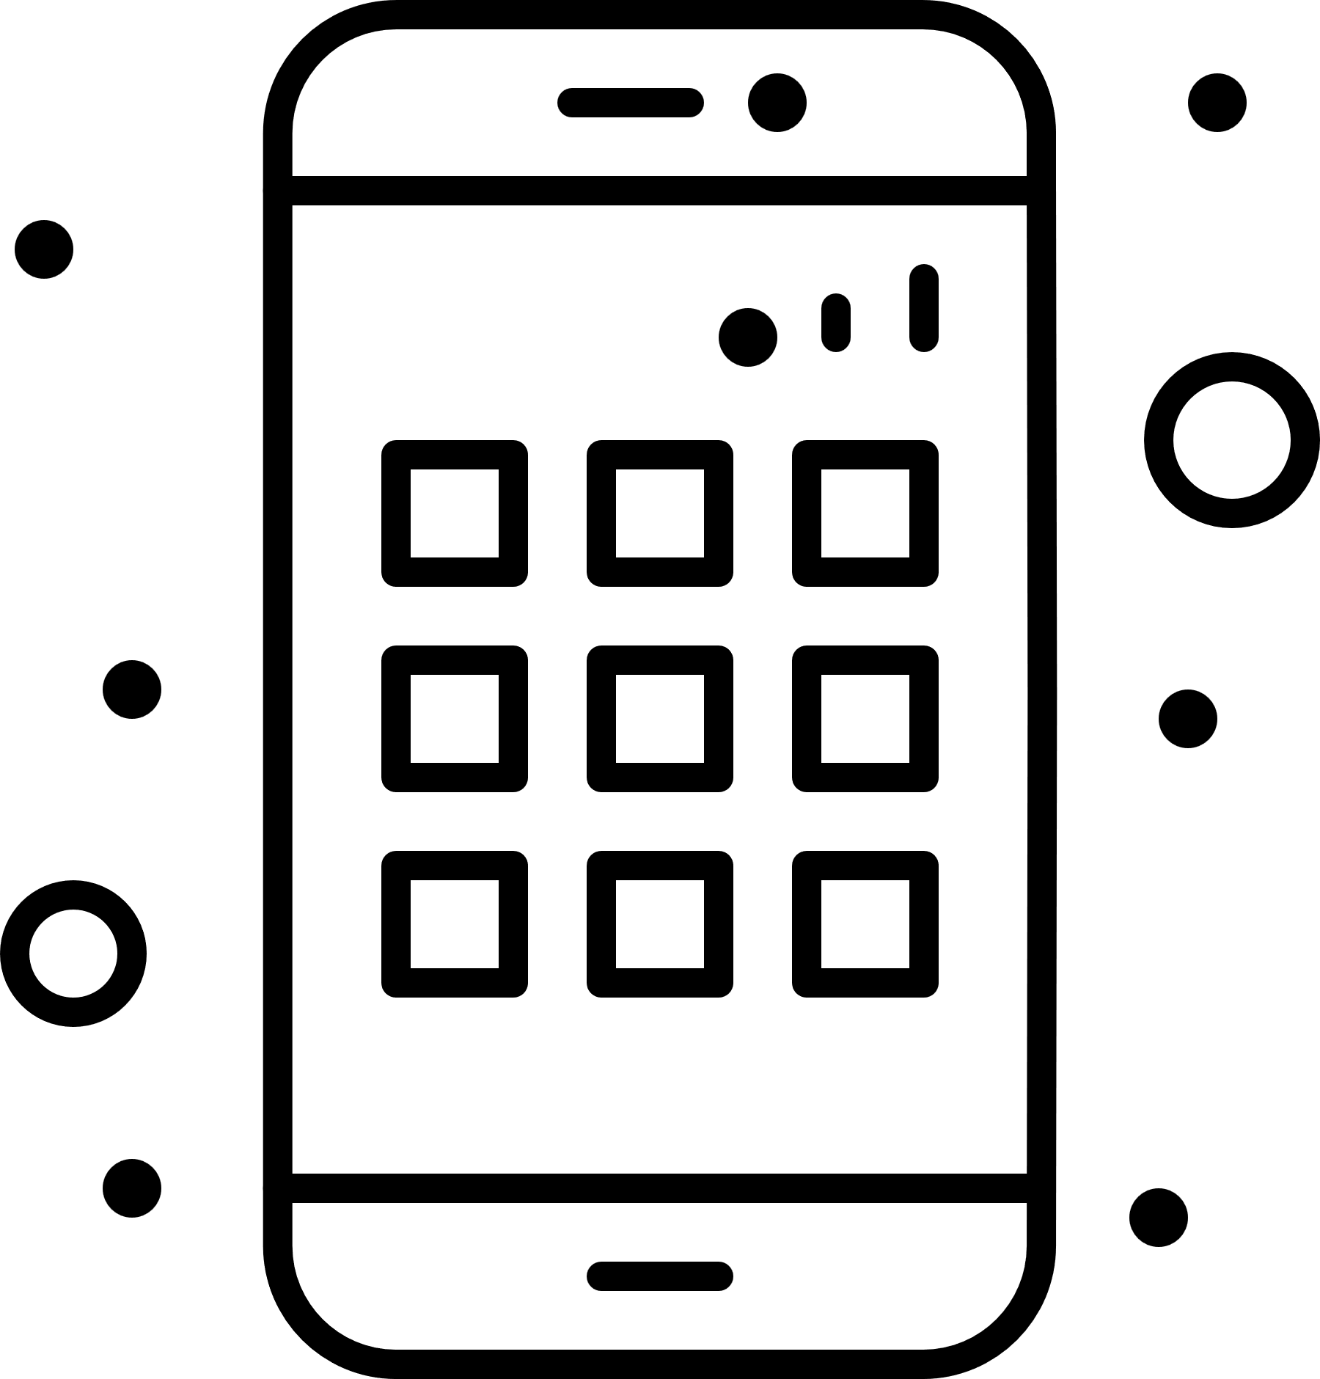
Proposed Solution
01
A peer-to-peer medicine-sharing app designed to address the challenges of limited access to essential medications in campus environments and residential complexes.
02
Enabling 24/7 Medicine Availability whihc promotes a collaborative framework where users help each other by offering surplus medications.
03
An easy-to-use system enabling users to request or share essential medications during urgent situations.
04
A Real-Time Notification Alert System when an user’s requested medicine is found or a request is accepted.

Slide 4
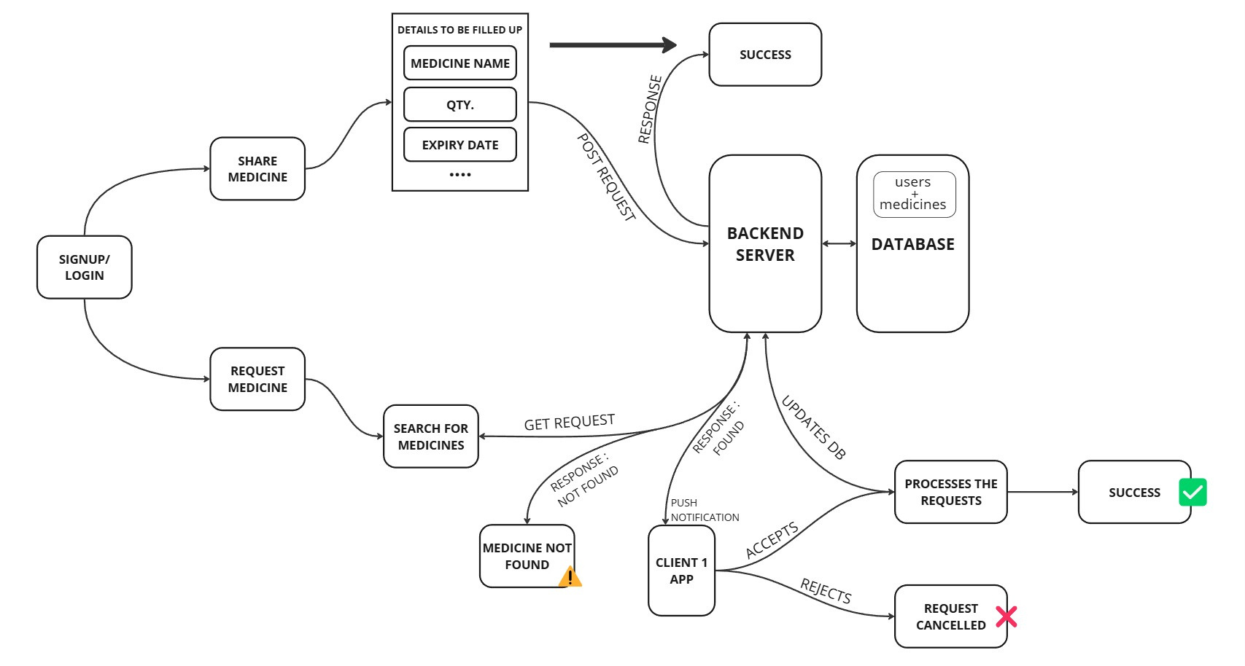
Architecture Overview of the APP

Slide 5
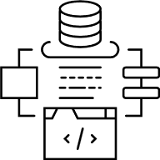
Architectural Flow Analysis
This is a schematic diagram illustrating the architectural flow of a Medicine Sharing App. Key components and processes include:
User Authentication: Users sign up or log in to access the platform.
Sharing Medicines: Users can share medicines by providing details such as medicine name, quantity, and expiry date. A POST request is sent to the backend server, which updates the database.
Requesting Medicines:
Users can search for medicines.
If the medicine is found, the backend notifies the relevant user (via a push notification) to accept or reject the request.
If the medicine is not found, the app displays a "Medicine Not Found" message.
Backend Server and Database:
The backend processes all requests, updates the database (containing user and medicine details), and handles responses.
Successful transactions (sharing or requesting) are updated in the database.
Response Flow:
If a request is accepted, the process completes successfully.
If a request is rejected or canceled, the app displays appropriate notifications to the users.

Slide 6
Thank You.

